Slide 1
Event Management System
By: RITIK JANARDHAN KOLI

Slide 2
Problem Statement
Event managers struggle to coordinate multiple service teams
Manual timelines → delays, miscommunication
No automated reminders or progress tracking
No real-time notifications or alerting system

Slide 3
Solution & Approach
Play Framework monolithic backend for Events, Tasks, Issues, Teams
Kafka Producers for event notifications
Akka microservice for Kafka consumer + Scheduler + Email
Slick ORM + MySQL for persistence
Classic Akka Actors for processing notifications

Slide 4
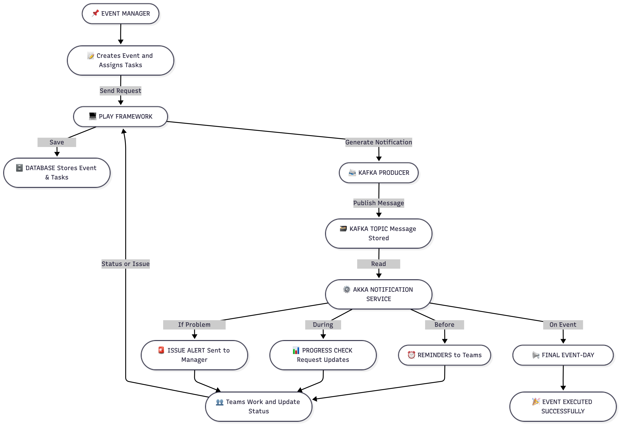
Functional Flow Diagram
Diagram Placeholder (Replace with actual diagrams)

Slide 5
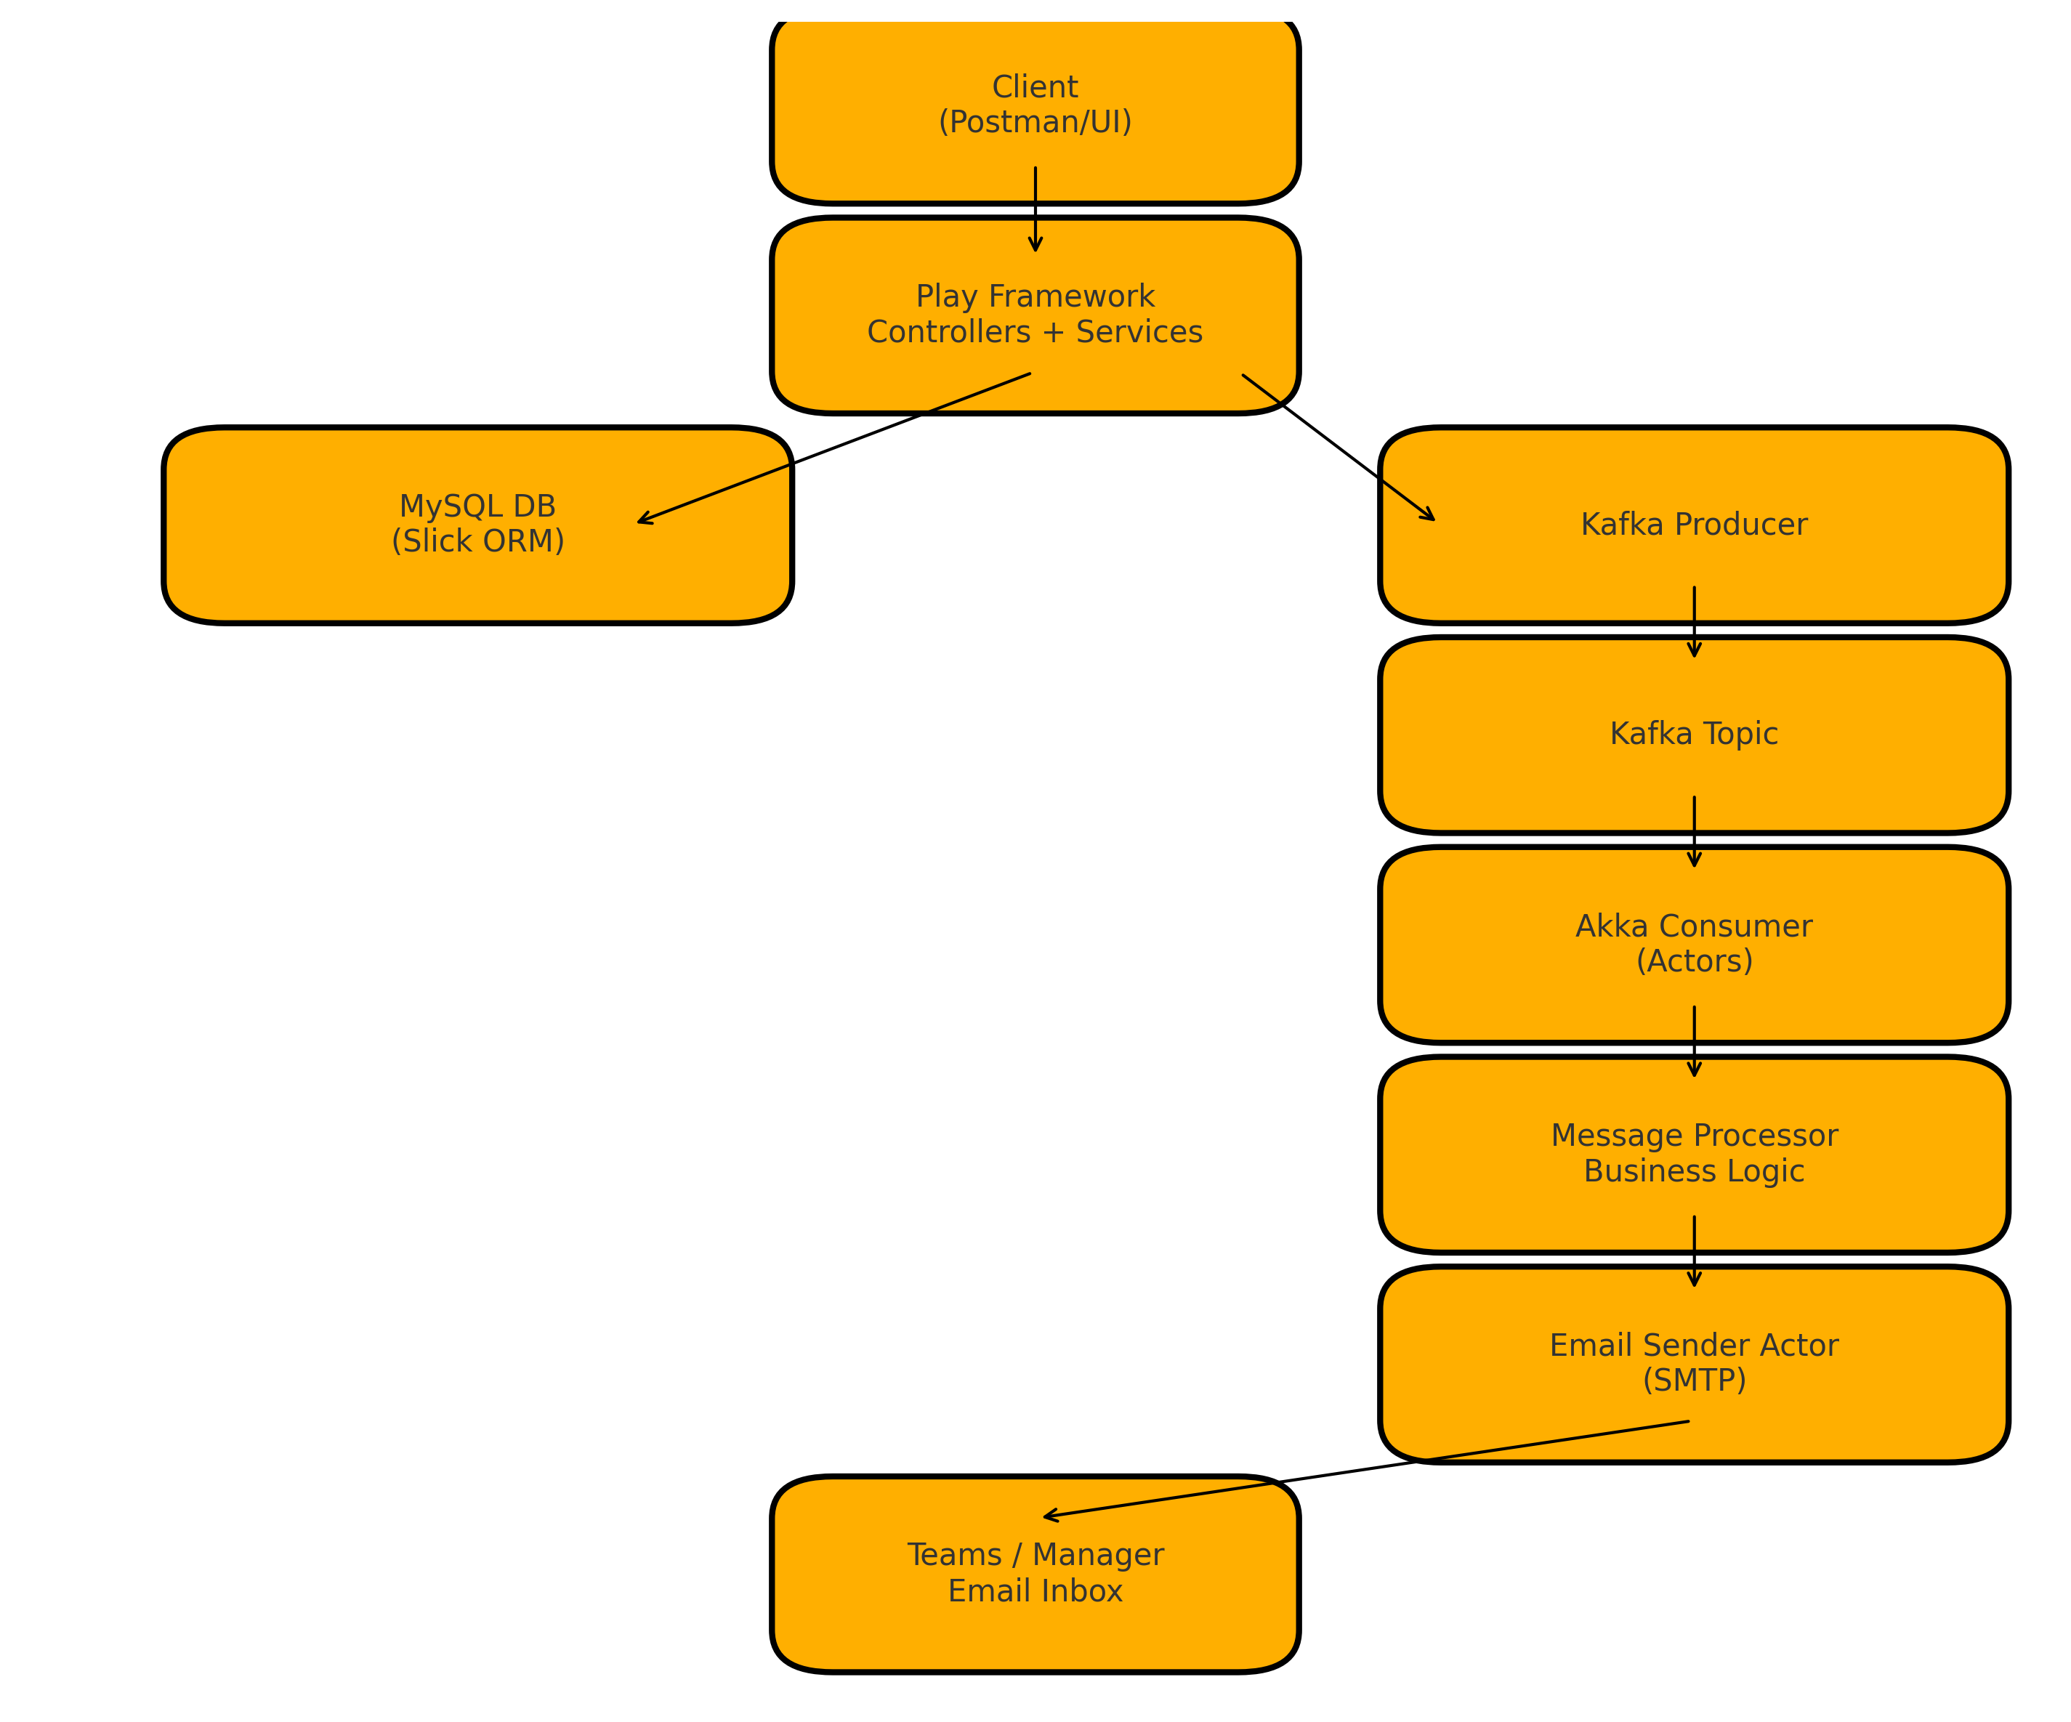
Overall Architecture Diagram

Slide 6
Deployment Plan
Play monolith deployed locally
Kafka broker hosted locally
Akka Microservice deployed separately
MySQL database
System communicates via Kafka topics

Slide 7
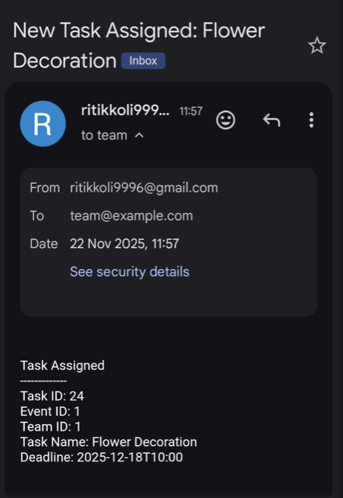
Output

Slide 8
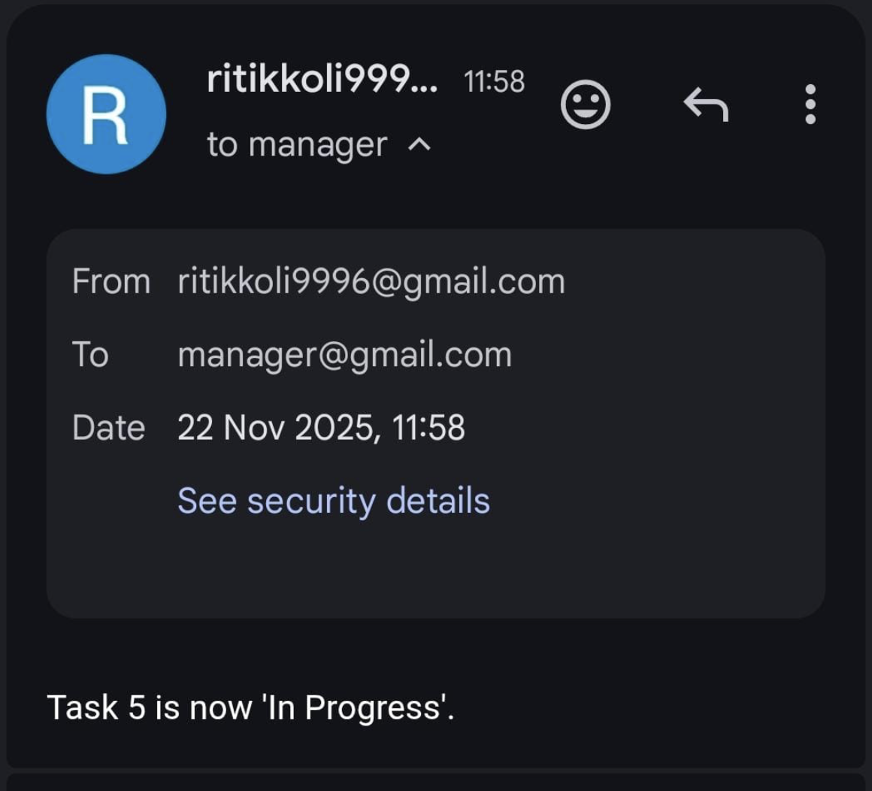
Output

Slide 9
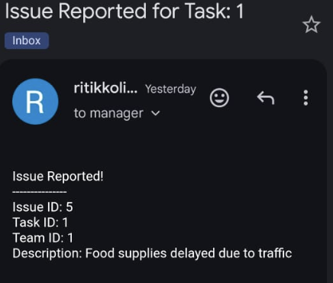
Output

Slide 10
Technologies Used
Scala 2.13 – functional programming, immutability
Play Framework – REST APIs, routing, JSON
Akka Classic Actors – async processing, scheduling
Akka Streams – Kafka consumption
Kafka – decoupled messaging architecture
Slick – ORM mapping to MySQL
Logback + SLF4J – structured logging

Slide 11
Features Implemented
Scala
Functional + OOP mix using case classes
Async operations with Future
Type-safe models & DB mapping
Play Framework
REST APIs for Events/Tasks/Issues
JSON handling with play-json
Slick integration for type-safe DB access
Akka
Actors for processing & email notifications
Akka Streams for Kafka consumption
Scheduler for periodic reminders
Kafka
Play app publishes event/task messages
Akka microservice consumes & triggers notifications
Event-driven, decoupled communication

